Slide 1
Creation, Providence, Prayer, Angels, Satan, Demons
The continuation of the Doctrine of God: 31 January 2017

Slide 2
Creation

Slide 3
Explanation and Scriptural Basis
Explanation and Scriptural Basis
God Created the Universe Out of Nothing
Biblical Evidence for Creation Out of Nothing
The Creation of the Spiritual Universe
The Direct Creation of Adam and Eve
The Creation of Time
The Work of the Son and of the Holy Spirit in Creation

Slide 4
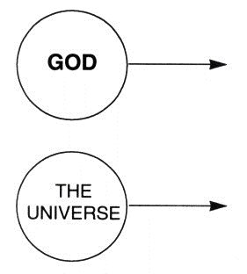
Explanation and Scriptural Basis
Creation is Distinct from God Yet Always Dependent Upon God

Slide 5
Explanation and Scriptural Basis
God Created the Universe to Show His Glory
The Universe God Created is Very Good

Slide 6
Explanation and Scriptural Basis
The Relationship Between Scripture and the Findings of Modern Science
When All the Facts are Rightly Understood, there will be “No Final Conflict” Between Scripture and Natural Science
There is a possibility that God created a “grown-up” universe.
There is a possibility of a break between Genesis 1:1 and 1:2 or between 1:2 and 1:3.
There is a possibility of a long day in Genesis 1.

Slide 7
Explanation and Scriptural Basis
There is a possibility that the flood affected the geological data.
The use of the word “kinds” in Genesis 1 may be quite broad.
There is a possibility of the death of animals before the fall.
Where the Hebrew word בָּרָא, H1343, is not used there is the possibility of sequence from previously existing things.

Slide 8
Explanation and Scriptural Basis
Some Theories About Creation Seem Clearly Inconsistent With the Teachings of Scripture.
Secular Theories
Theistic Evolution
Objections

Slide 9
Explanation and Scriptural Basis
Notes on the Darwinian Theory of Evolution
Current Challenges to Evolution
“After more than a hundred years . . .” 136
“The vast and complex mutations . . .” 136
“The subsequent 130 years of intensive archeological . . .” 136
“Advances in Molecular Biology . . .” 136
“Probably the greatest difficulty for all evolutionary theory . . .” 136

Slide 10
Explanation and Scriptural Basis
The Destructive Influences of Evolution in Modern Thought
The Theory of a “Gap” Between Genesis 1:1 and 1:2

Slide 11
Explanation and Scriptural Basis
The Age of the Earth: Some Preliminary Considerations
There are Gaps in the Genealogies of the Bible
The Age of the Human Race
Did Animals Die Before the Fall?
What About Dinosaurs?
Are the Six Days of Creation Twenty-four Hour Days?

Slide 12
Explanation and Scriptural Basis
Both “Old Earth” and “Young Earth” Theories are Valid Options for Christians Who Believe the Bible Today
“Old Earth” Theories of Creation
Day-Age View:
Literary Framework View
“Young Earth” Theory of Creation
Creation With an Appearance of Age (Mature Creationism)
Flood Geology

Slide 13
Explanation and Scriptural Basis
Conclusions About the Age of the Earth
The Need for Further Understanding

Slide 14
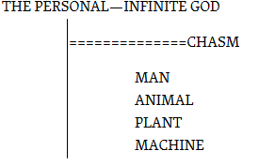
God and Creation

Slide 15
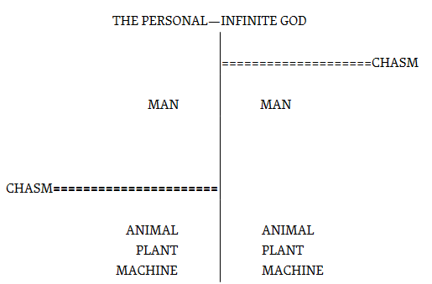
God and Creation

Slide 16
God’s Providence
Preservation, Concurrence, Government

Slide 17
Explanation and Scriptural Basis
Preservation
Concurrence
Inanimate Creation
Animals
Seemingly “Random” or “Chance” Events

Slide 18
Explanation and Scriptural Basis
Events Fully Caused by God and Fully Caused by the Creature as Well
The Affairs of Nations
All Aspects of Our Lives

Slide 19
Explanation and Scriptural Basis
What About Evil
Analysis of Verses Relating to God and Evil
God Uses All Things to Fulfill His Purposes and Even Uses Evil for His Glory and for Our Good
Nevertheless, God Never Does Evil, and Is Never to Be Blamed for Evil
God Rightfully Blames and Judges Moral Creatures for the Evil They Do

Slide 20
Explanation and Scriptural Basis
Evil Is Real, Not an Illusion, and We Should Never Do Evil, for It Will Always Harm Us and Others
In Spite of All of the Foregoing Statements, We Have to Come to the Point Where We Confess That We Do Not Understand How It Is That God Can Ordain That We Carry Out Evil Deeds and Yet Hold Us Accountable for Them and Not be Blamed Himself?

Slide 21
Explanation and Scriptural Basis
Are We “Free”? Do We Have “Free Will”?

Slide 22
Explanation and Scriptural Basis
Government
Scriptural Evidence
Distinctions Concerning the Will of God
The Decrees of God

Slide 23
Explanation and Scriptural Basis
The Importance of Human Actions
We Are Still Responsible for Our Actions
Our Actions Have Real Results and Do Change the Course of Events
Prayer is One Specific Kind of Action That Has Definite Results and That Does Change the Course of Events.
In Conclusion: We Must Act!
What if We Cannot Understand This Doctrine Fully?

Slide 24
Further Practical Application
Do Not Be Afraid, but Trust in God
Be Thankful for All Good Things That Happen
There is No Such Thing as “Luck” or “Chance”

Slide 25
E. Another Evangelical View: the Arminian Position
The Verses Cited as Examples of God’s Providential Control Are Exceptions and Do Not Describe the Way That God Ordinarily Works in Human Activity.
The Calvinist View Wrongly Makes God Responsible for Sin.
Choices Caused by God Cannot Be Real Choices.
The Arminian View Encourages Responsible Christian Living, While the Calvinistic View Encourages a Dangerous Fatalism.

Slide 26
F. Response to the Arminian Position
Are These Scripture Passages Unusual Examples, or Do They Describe the Way God Works Ordinarily?
Does the Calvinistic Doctrine of God’s Providence Make God Responsible for Sin?
Can Choices Ordained by God Be Real Choices?
Does a Calvinistic View of Providence Encourage Either a Dangerous Fatalism or a Tendency to “Live Like Arminians”?

Slide 27
5. Additional Objections to the Arminian Position
On an Arminian View, How Can God Know the Future?
On an Arminian View, How Can Evil Exist if God Did Not Want It?
On an Arminian View, How Can We Know that God Will Triumph Over Evil?
The Difference in the Unanswered Questions

Slide 28
Miracles

Slide 29
EXPLANATION AND SCRIPTURAL BASIS
A. Definition
B. Miracles as Characteristic of the New Covenant Age
C. The Purposes of Miracles
D. Were Miracles Restricted to the Apostles?

Slide 30
D. Were Miracles Restricted to the Apostles?
1. An Unusual Concentration of Miracles in the Apostles’ Ministry.
2. What Are the “Signs of an Apostle” in 2 Corinthians 12:12?
3. Norman Geisler’s Restrictive Definition of Miracles.
4. Hebrews 2:3–4.
5. Conclusion: Were Miracles Restricted to the Apostles?

Slide 31
EXPLANATION AND SCRIPTURAL BASIS
E. False Miracles
F. Should Christians Seek Miracles Today?

Slide 32
Prayer

Slide 33
Explanation and Scriptural Basis
Why Does God Want Us to Pray?
The Effectiveness of Prayer
Prayer Changes the Way God Acts
Effective Prayer is Made Possible by our Mediator, Jesus Christ
What is Prayer “In Jesus’ Name”?
Should We Pray to Jesus and to the Holy Spirit?
The Role of the Holy Spirit in Our Praying

Slide 34
Explanation and Scriptural Basis
Some Important Considerations in Effective Prayer
Praying According to God’s Will
Praying With Faith
Obedience
Confession of Sins
Forgiving Others
Humility
Continuing in Prayer Over Time
Praying Earnestly
Waiting on the Lord
Praying in Private
Praying with Others
Fasting

Slide 35
Explanation and Scriptural Basis
What About Unanswered Prayer?
Prayer and Thanksgiving

Slide 36
Angels, Satan, and Demons

Slide 37
A. What are Angels?
Created Spiritual Beings
Other names for angels
Other kinds of heavenly beings
The “Cherubim”
The “Seraphim”
The Living Creatures

Slide 38
4. More on Angels
Rank and Order Among the Angels
Names of Specific Angels
Only One Place at One Time
How Many Angels Are There?
Do People Have Individual Guardian Angels?
Angels Do Not Marry
The Power of Angels
Who is the Angel of the Lord?
When Were Angels Created?

Slide 39
B. The Place of Angels in God’s Purpose
Angels Show the Greatness of God’s Love and Plan for Us
Angels Remind Us that the Unseen World is Real
Angels are Examples for Us
Angels Carry Out Some of God’s Plans
Angels Directly Glorify God

Slide 40
C. Our Relationship to Angels
We Should be Aware of Angels in Our Daily Lives
Cautions Regarding Our Relationship with Angels
Beware of Receiving False Doctrine from Angels
Do Not Worship Angels, Pray to Them, or Seek Them
Do Angels Appear to People Today?

Slide 41
Satan and Demons

Slide 42
Explanation and Scriptural Basis
The Origin of Demons
Satan as the Head of Demons

Slide 43
Explanation and Scriptural Basis
The Activity of Satan and Demons
Satan Was the Originator of Sin
Demons Oppose and Try to Destroy Every Work of God
Yet Demons are Limited by God’s Control and Have Limited Power

Slide 44
Explanation and Scriptural Basis
There Have Been Differing Stages of Demonic Activity in the History of Redemption
In the Old Testament
During the Ministry of Jesus
During the New Covenant Age
During the Millennium
At the Final Judgement

Slide 45
D. Our Relationship to Demons
Are Demons Active in the World Today?
Not All Evil and Sin is from Satan, but Some is.
Can a Christian be Demon Possessed
How Can Demonic Influences be Recognised?
Jesus Gives All Believers Authority to Rebuke Demons and Command Them to Leave.
Appropriate Use of the Christian’s Spiritual Authority in Ministry to Other People
We Should Expect the Gospel to Come in Power to Triumph Over the Works of the Devil

