Slide 1
Introduction to Biblical Interpretation Lecture 9
Maritime Christian College
Scott Jacobsen, Instructor

Slide 2
Today’s Agenda
So, what’s a Scythian?
Your Bible readings
Your Vocabulary
Interpreting the Gospels
Understanding the Parables

Slide 3
Understanding the Gospels
Lecture 9

Slide 4
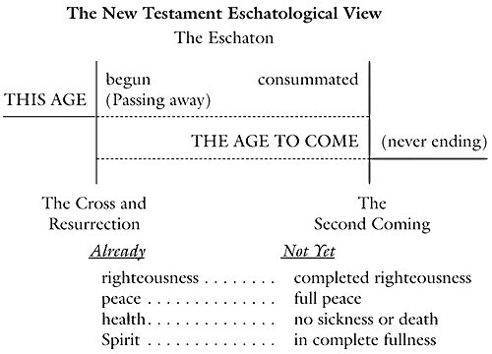
Notes:
Fee, Gordon D., and Douglas K. Stuart. How to Read the Bible for All Its Worth. 3rd ed. Grand Rapids, MI: Zondervan Publishing House, 1993., page 147.

Slide 5
The Gospels: Terms
Synoptic
Term applied to Matthew, Mark, and Luke because they see the ministry of Jesus from generally the same point of view, which is quite different from that of the Gospel of John.
Walter A. Elwell and Barry J. Beitzel, Baker Encyclopedia of the Bible (Grand Rapids, MI: Baker Book House, 1988), 2008.

Slide 6
The Gospels: Terms
Harmony of the Gospels: “A work that seeks to harmonize the four Gospel accounts. Sometimes ‘harmony’ is used synonymously with synopsis of the Gospels or a Gospel parallel, but the function of a harmony is to interrelate the four Gospel accounts into a single continuous story of Jesus. A synopsis is a tool for the critical study of the Gospels that sets out the various pericopes of Matthew, Mark and Luke (and sometimes John) in parallel columns for detailed comparison and analysis.”
Notes:
Arthur G. Patzia and Anthony J. Petrotta, Pocket Dictionary of Biblical Studies (Downers Grove, IL: InterVarsity Press, 2002), 54.

Slide 7
The Nature of the Gospels
“Two Levels”
First, there was the purely historical concern that this is who Jesus was and this is what he said and did; and this is the Jesus—crucified and raised from the dead—whom we now worship as the risen and exalted Lord.
Notes:
Gordon D. Fee and Douglas K. Stuart, How to Read the Bible for All Its Worth, 3rd ed. (Grand Rapids, MI: Zondervan Publishing House, 1993), 129.

Slide 8
The Nature of the Gospels
“Two Levels”
Second, there was the existential concern of retelling this story for the needs of later communities that did not speak Aramaic but Greek, and that did not live in a basically rural, agricultural, and Jewish setting, but in Rome, or Ephesus, or Antioch, where the gospel was encountering an urban, pagan environment.
Notes:
Gordon D. Fee and Douglas K. Stuart, How to Read the Bible for All Its Worth, 3rd ed. (Grand Rapids, MI: Zondervan Publishing House, 1993), 129.

Slide 9
Understanding the Gospels
Historical Setting of Jesus
Historical Context of the Writers

Slide 10
Historical Setting: An Example
Refer to Luke 2:1–21 (NIV)

Slide 11
Luke 2:1-20
A Shepherds in field 8
B Angel appears--fear 9
C Angelic Announcement 10-11
D Lying in a manger 12
E Glory to God 13-15
D' Lying in a manger 16
C' Sephardic Announcement 17
B' Shepherds appear--others wonder 18-19
A' Shepherds return to field 20
Conclusion: "His name is Jesus" 21
The centre of the story is God, and His Glory.

Slide 12
Historical Notes
Emperor Worship
Subversive intent: anti-emperor
Choirs worshipped the emperor
Augustus was said to be “the bringer of Peace”
A Subversive text: God is the centre
Heavenly choirs worship the King of Kings
Real peace is brought by God in Christ

Slide 13
Historical Context
“euangélion is particularly important in the emperor cult. The emperor is a divine ruler who controls nature, dispenses healing, serves as a protective god, and brings good fortune, his birth being accompanied by cosmic signs. Imperial messages, then, are joyous ones, since what he says is a divine act implying good and salvation. The first euangélion is news of his birth, then his coming of age, then his accession. Offerings and yearly festivals celebrate the new and more hopeful era that dawns with him. “
Notes:
Gerhard Kittel, Gerhard Friedrich, and Geoffrey William Bromiley, Theological Dictionary of the New Testament (Grand Rapids, MI: W.B. Eerdmans, 1985), 269–270.

Slide 14
Historical Context
“His accession to the throne is a gospel for his subjects. This imperial euangélion, like that of the NT, has a Near Eastern source, but to the many imperial messages the NT opposes the one gospel, and to the many accessions the one proclamation of God’s kingdom. Again, the NT may use familiar language, but it associates it with the scandal of the cross (1 Cor. 1:17), penitence, and judgment, so that it must have seemed ironical to some (Acts 17:32). Caesar and Christ confront one another. They have much in common, for both claim to be gospel, but they belong to different worlds.”

Slide 15
Historical Context
“It is a day which we may justly count as equivalent to the beginning of everything—if not in itself and in its own nature, at any rate in the benefits it brings—inasmuch as it has restored the shape of everything that was failing and turning into misfortune, and has given a new look to the Universe at a time when it would gladly have welcomed destruction if Caesar had not been born to be the common blessing of all men.…

Slide 16
Historical Context
Whereas the Providence (pronoia) which has ordered the whole of our life, showing concern and zeal, has ordained the most perfect consummation for human life by giving to it Augustus, by filling him with virtue for doing the work of a benefactor among men, and by sending in him, as it were, a saviour for us and those who come after us, to make war to cease, to create order everywhere …

Slide 17
Historical Context
“. . . and whereas the birthday of the God [Augustus] was the beginning for the world of the glad tidings [in the Greek the ‘Evangel’] that have come to men through him … Paulus Fabius Maximus, the proconsul of the province … has devised a way of honouring Augustus hitherto unknown to the Greeks, which is, that the reckoning of time for the course of human life should begin with his birth”
Notes:
U. Becker, “Gospel, Evangelize, Evangelist,” ed. Lothar Coenen, Erich Beyreuther, and Hans Bietenhard, New International Dictionary of New Testament Theology (Grand Rapids, MI: Zondervan Publishing House, 1986), 108.

Slide 18
Interpreting Parables
Lecture 9

Slide 19
Parables: Terms
Parable
“A short instructive story that contains an analogy.”
Notes:
Matthew S. DeMoss, Pocket Dictionary for the Study of New Testament Greek (Downers Grove, IL: InterVarsity Press, 2001), 92.

Slide 20
Parables: Terms
Metaphor
“In general usage, an implied comparison in which the characteristics, qualities or actions of one thing are applied to another (e.g., speaking of God as shepherd).”
Notes:
Arthur G. Patzia and Anthony J. Petrotta, Pocket Dictionary of Biblical Studies (Downers Grove, IL: InterVarsity Press, 2002), 79.

Slide 21
Parables: Terms
Simile
A comparison of two basically unlike things, frequently using the word like or as (Lat. similis, “alike”). See 1 Corinthians 3:10.
1 Corinthians 3:10 (NIV)
¹⁰ By the grace God has given me, I laid a foundation as a wise builder, and someone else is building on it. But each one should build with care.
Notes:
Matthew S. DeMoss, Pocket Dictionary for the Study of New Testament Greek (Downers Grove, IL: InterVarsity Press, 2001), 113.

Slide 22
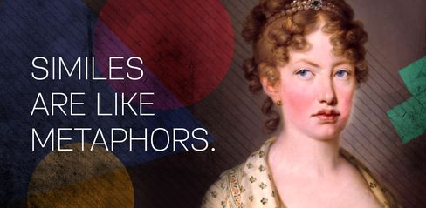

Slide 23
Assignment on Parables
Read Matthew 13
Select a parable. Does this parable occur in other Gospels?
Locate the pericope
Do the worksheet based upon that parable

