Slide 1
Introduction to Biblical Interpretation Lecture 6
Maritime Christian College
Scott Jacobsen, Instructor

Slide 2
Today’s Agenda
Review of Assignments & Questions
Cross References
Concordance
Old Testament Narratives

Slide 3
Notes on Assignments
Use the worksheet
Outlining
Sub-points follow the points immediately above it.
“Stay on the Line”
When outlining the text, make certain that you .are only outlining what the text actually says, not what you “import” onto it.
Name on the worksheet
“Assignment 2 (last name) .docx” (or rtf, etc.)
Please do not send pdf files—hard to convert well.
I will return worksheet as “Assignment 2 (last name) marked.”

Slide 4
Cross References

Slide 5
Concordance
https://www.backtothebible.ca/bible/?gclid=CjwKEAjwydK_BRDK34GenvLB61YSJACZ8da3Vz-_XFRsQMDwJ-_ierwWNThSdkM_RDNss3RQ-8rkghoCICPw_wcB
http://www.biblestudytools.com/concordances/

Slide 6
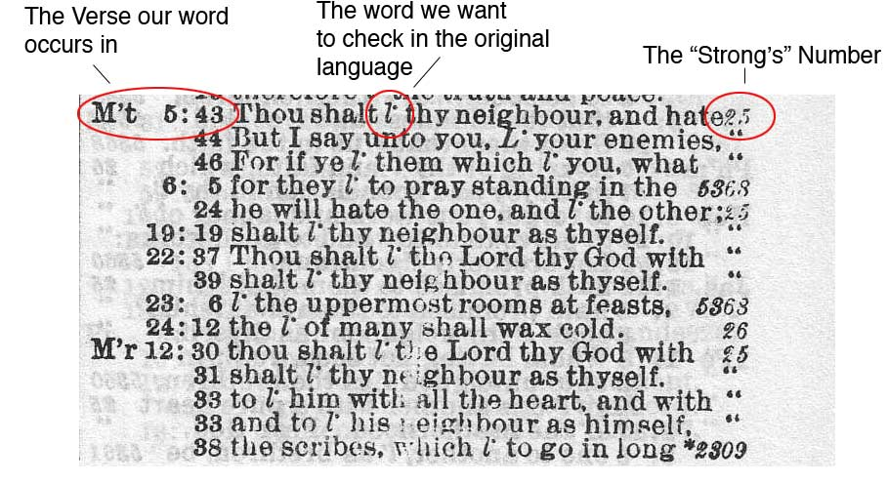
Concordance

Slide 7
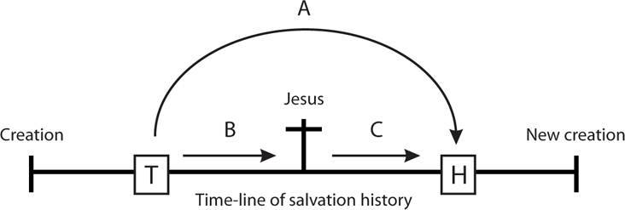
Be aware

Slide 8
New Assignment: Old Testament Narrative
Text: “David and Goliath”
Locate the pericope
Use the Worksheet and answer the questions
Put your name on the worksheet
If possible, show your work beneath each heading of the worksheet

Slide 9
Old Testament Narrative
“What happens when you begin studying a biblical passage by considering application for today? By contrast, what happens when you look through the lens of the passage’s literary and historical context before approaching application for today?”

Slide 10
Narrative: Three Levels
(from Fee and Stuart)
3rd Level: Metanarrative
2nd Level: the Covenant People of God
1st Level: the individual stories

Slide 11
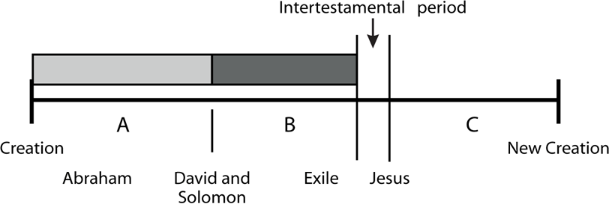
The Metanarrative

Slide 12
Interpreting Narratives
(from Fee and Stuart)
Not Allegories
Not moral stories (although there may be a moral element)
Narratives illustrate the explicit

Slide 13
Characteristics of Hebrew Narrative
The Narrator
Scenes
Characters
Dialogue

Slide 14
Characteristics of Hebrew Narrative
Plot
Setting
Climax
Anti-climax
Features of Structure
Repetition
Inclusion (inclusio)
Chiasm
God as the ultimate character

Slide 15
Errors in Interpreting Narrative
Allegorizing
Decontextualizing
Selectivity
Moralizing
Personalizing
Misappropriation
False appropriation
False combination
Redefinition

Slide 16
Interpreting Narratives (readings from Fee & Stuart)
An Old Testament narrative usually does not directly teach a doctrine.
An Old Testament narrative usually illustrates a doctrine or doctrines taught propositionally elsewhere.
Narratives record what happened—not necessarily what should have happened or what ought to happen every time. Therefore, not every narrative has an individual identifiable moral application.
Notes:
Test note

Slide 17
Interpreting Narratives
What people do in narratives is not necessarily a good example for us. Frequently, it is just the opposite.
Most of the characters in Old Testament narratives are far from perfect—as are their actions as well.

Slide 18
Interpreting Narratives
We are not always told at the end of a narrative whether what happened was good or bad. We are expected to be able to judge this on the basis of what God has taught us directly and categorically elsewhere in Scripture.
All narratives are selective and incomplete. Not all the relevant details are always given (cf. John 21:25). What does appear in the narrative is everything that the inspired author thought important for us to know.

Slide 19
Interpreting Narratives
Narratives are not written to answer all our theological questions. They have particular, specific, limited purposes and deal with certain issues, leaving others to be dealt with elsewhere in other ways.
Narratives may teach either explicitly (by clearly stating something) or implicitly (by clearly implying something without actually stating it).
In the final analysis, God is the hero of all biblical narratives.

Slide 20
Points to Remember
What did the text mean to the original writer?
What does the text mean in the light of the Gospel?
What is its specific meaning to me or my hearers now?
Goldsworthy, Gospel and Kingdom, 1981

